Slide 1
CHE 652
Portfolio Optimization
Maximizing Returns, Minimizing risks
Group - 8

Slide 2
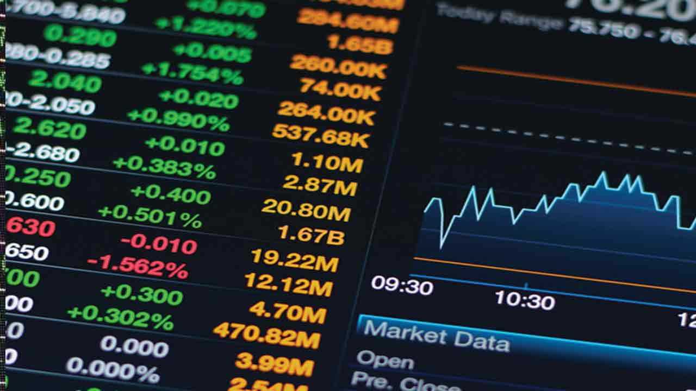
.
Portfolio optimization is the process of selecting the best portfolio (combination of assets) from a set of feasible portfolios to achieve the highest expected return for a given level of risk, or the lowest risk for a given level of expected return.

Slide 3
Objectives
Maximize Returns: Achieve the highest possible return for a given level of risk.
Minimize Risk: Reduce portfolio volatility and downside risk.
Diversification: Spread investments across different asset classes to mitigate risks.

Slide 4
Methods
Modern Portfolio Theory (MPT): Developed by Harry Markowitz, MPT uses mathematical optimization to construct an efficient frontier of portfolios that offer the maximum possible expected return for a given level of risk.
Mean-Variance Optimization: A quantitative tool that helps investors select portfolios that maximize expected returns for a given level of risk.
Sharpe Ratio: Measures risk-adjusted performance; portfolios with higher Sharpe ratios are considered better.

Slide 5
Steps in portfolio optimization
Define Objectives: Determine investment goals, risk tolerance, and time horizon.
Asset Selection: Identify a set of suitable assets to include in the portfolio.
Expected Returns & Risk Assessment: Estimate expected returns, volatilities, and correlations of selected assets.
Optimization: Use mathematical models to find the optimal portfolio that maximizes returns or minimizes risk based on defined parameters.
Backtesting & Evaluation: Test the performance of the optimized portfolio using historical data and make necessary adjustments.

Slide 6
Why portfolio optimization is important?
Portfolio optimization is important because it helps investors construct well-balanced portfolios that maximize returns, minimize risk, and align with their financial goals and risk tolerance. By utilizing quantitative methods and strategic asset allocation, portfolio optimization provides a systematic approach to investment management, leading to better investment outcomes and long-term financial success.

Slide 7
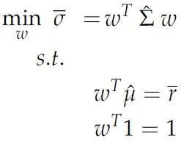
Markowitz
Mean-variance
Portfolio
Theory
It's based on the idea that investors are extremely averse to risk, and will only accept more risk if compensated by higher expected returns.

Slide 8
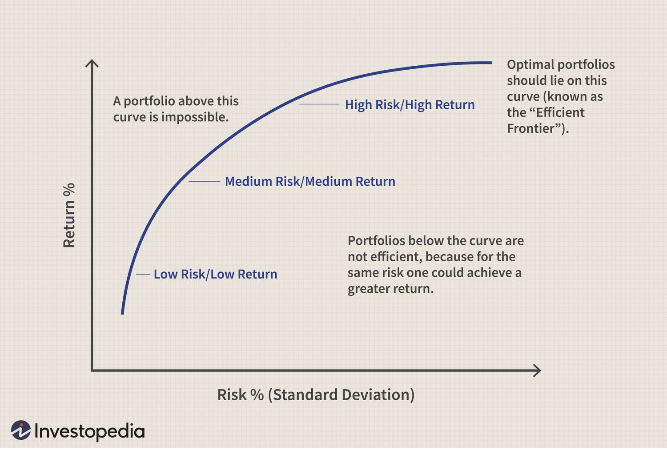
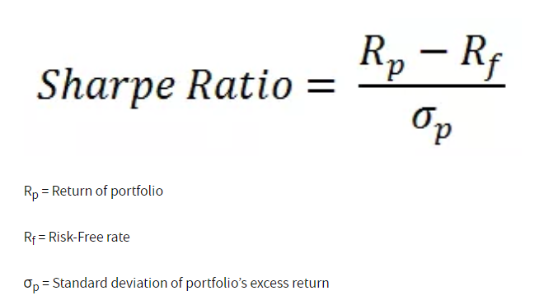
Risk free rate Sharpe ratio
Theoretical number within the capital markets that pertains to an investment that provides guaranteed returns with negligible or zero risk.
It is a way to measure the performance of an investment by taking risk into account

Slide 9
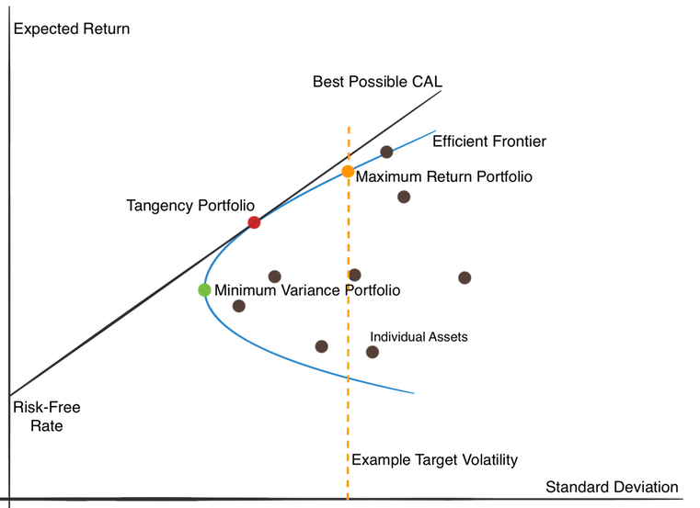
Efficient
Frontier
.

Slide 10
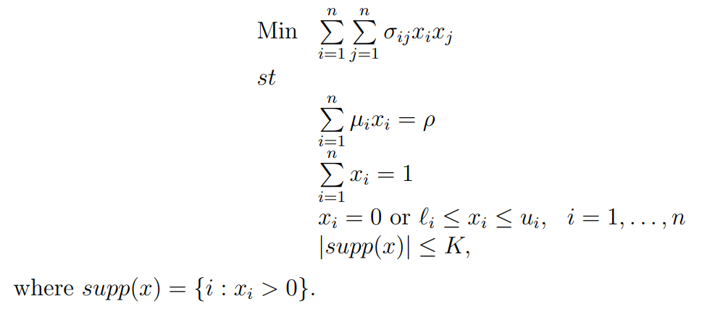
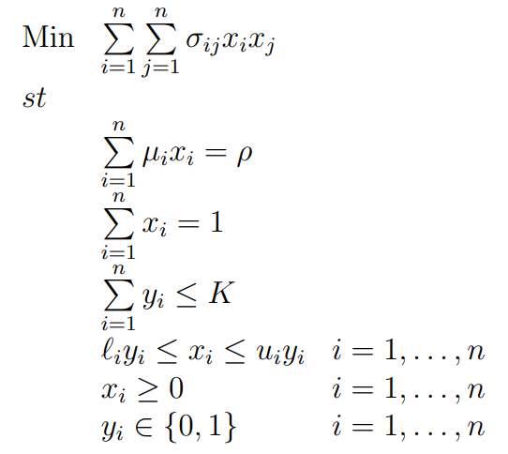
The Limited Assets Markowitz Model
We now add to the MV model the realistic constraint that no more than K assets should be held in the portfolio.
.
MIQP Formulation

Slide 11
Methodology

Slide 12
Basic Markowitz Model
Set -
i ∈ I {list of stocks - s₁, s₂,…….., s_{N}}
Variables -
w - vector of length N corresponding to the weight assigned to each stock
Parameters -
r - required rate of return
μ - vector of length N corresponding to the mean rate of return of each stock
∑ - matrix of size N✕N with ∑_{ij} = Cov(s_{i},s_{j})

Slide 13
Maximizing Sharpe Ratio
Set -
i ∈ I {list of stocks - s₁, s₂,…….., s_{N}}
Variables -
y - vector of length N corresponding to the weight assigned to each stock
Parameters -
r_{f} - risk-free rate
μ - vector of length N corresponding to the mean rate of return of each stock
∑ - matrix of size N✕N with ∑_{ij} = Cov(s_{i},s_{j})

Slide 14
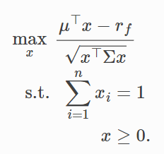
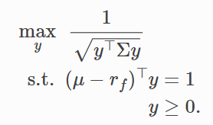
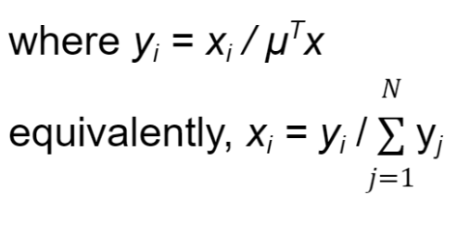
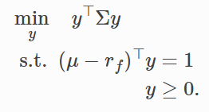
How to do Sharpe Ratio Optimization
Return
Risk

Slide 15
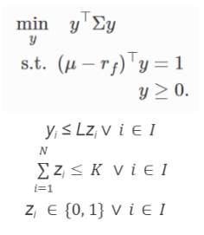
Adding Additional Constraints
To make the model more realistic, we can add some more constraints to any of the above two formulations. Some important constraints are as follows -
Maximum Weight constraint - Limit the weight fraction of each asset
Number of asset constraint - Limit on number of stocks to invest in

Slide 16
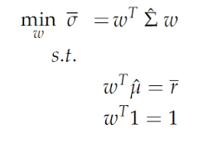
Our Final Models
Mean Variance Optimization
Sharpe Ratio Maximization
Limited Assets Model

Slide 17
Results

Slide 18
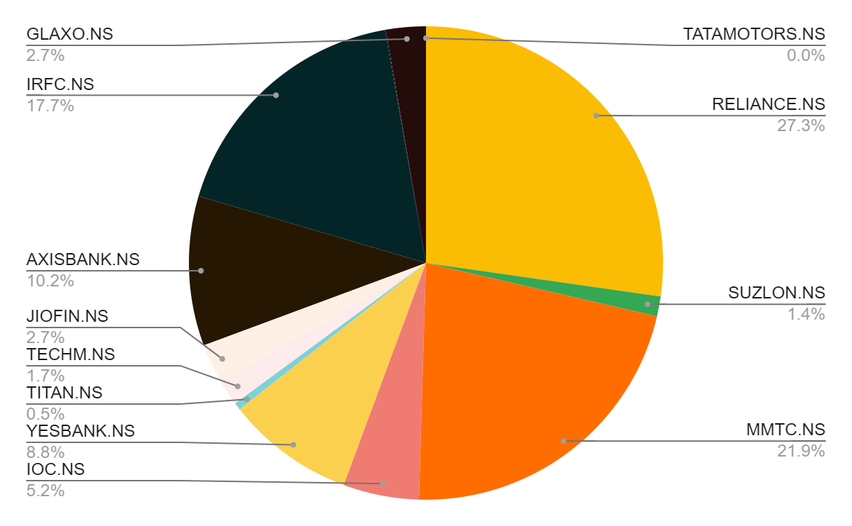
Basic Markowitz Model:
Volatility - 0.007566
Expected Return - 0.000831

Slide 19
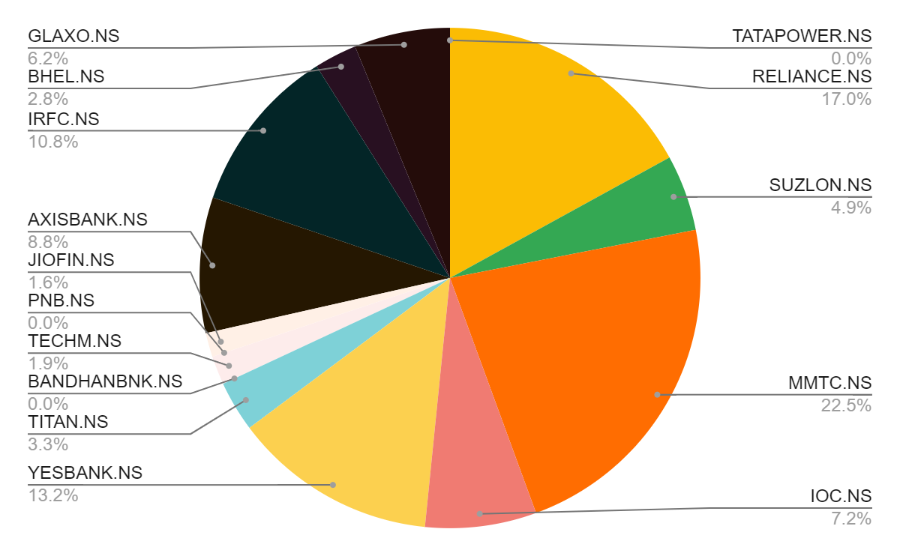
Maximizing the sharpe ratio:
Volatility - 0.060892
Expected Return 0.001686

Slide 20
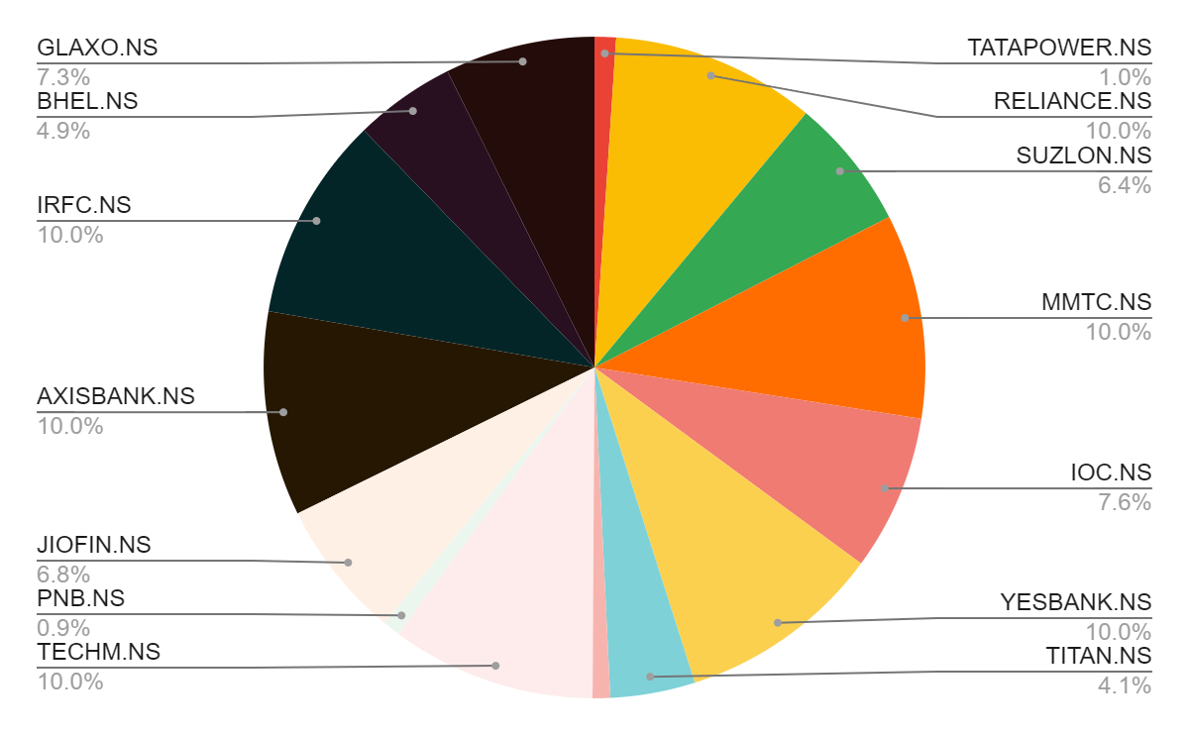
The Limited Assets Model:
Volatility - 0.064062
Expected Return - 0.002419

Slide 21
Analysis
Model | Volatility | Expected Return
Basic Markowitz Model | 0.007566 | 0.000831
Sharpe Ratio Model | 0.060892 | 0.001686
Limited Asset Model | 0.064062 | 0.002419
As we move from Basic Markowitz Model to Sharpe Ratio model both Expected Return and Volatility increases. When we added the limit on number of assets, there was again an increase in expected return and volatility value.

Slide 22
Conclusion
Markowitz model and Sharpe Ratio model both give optimal portfolios but their mode of working is different, Markowitz model takes the safest way minimizing the risk while Sharpe Ratio model takes a balanced approach between risk and return. The choice of model depends on the investor.
Adding additional constraints makes the model more realistic but the parameter values need to be chosen appropriately otherwise the portfolio may not be upto the mark or even problem may become infeasible.

Slide 23
THANK YOU
OUR TEAM
•Ronit Agarwal (200819) - Market Study, helping in Python Code and Result Formulations
•Vaibhav Goyal (201075) - Writing the Python code and Result Formulations
•Aditya Singh Kaurav (200055) - Report Writing (Introduction, Methodology)
•Gaurang Dangayach (200373) - Model Formulation and Result Analysis
•Lokesh (200547) - Making PowerPoint Presentation and research.

